Slide 1

Exponential discounting anomalies
Notes on Behavioural Economics
Jason Collins

Slide 2
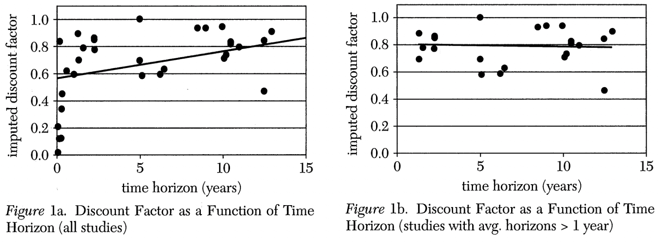
Frederick, Shane, George Loewenstein, and Ted O'Donoghue (2002) "Time Discounting and Time Preference: A Critical Review”, Journal of Economic Literature, 40(2): 351-401

Slide 3


Slide 4
$15
Three months | One year | Three years

Slide 5
$15
Three months | One year | Three years
$30 | $60 | $100

Slide 6
$15
Three months | One year | Three years
$30 | $60 | $100
277% | 139% | 63%

Slide 7
$20 now or $50 in three months?
$20 in one week or $50 in three months and one week?

Slide 8
Choice A:
Choose between one apple today and two apples tomorrow.
Choice B:
Choose between one apple in one year and two apples in one year plus one day.

Slide 9


